Slide 1
Music (Songs) Played on Device

Slide 2
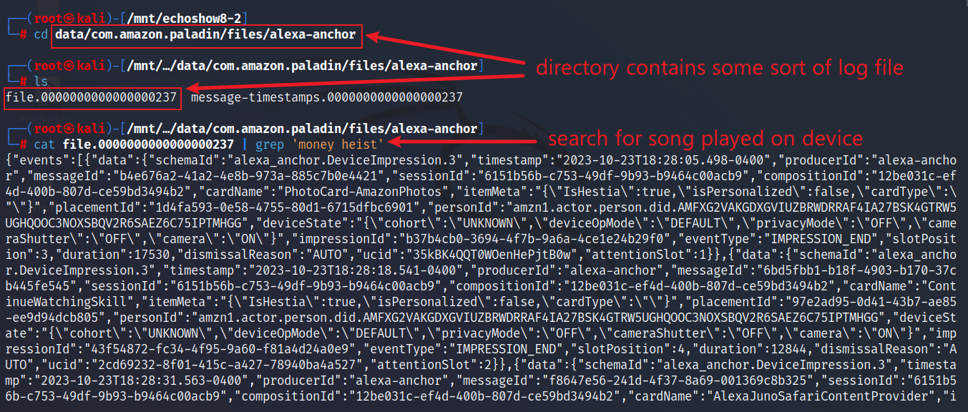
Echo Show Log File
Directory files/alexa-anchor under com.amazon.paladin package contains log file
The file logs all activities on Echo Show device
Go to com.amazon.paladin/files/alexa-anchor and search song keyword in file

Slide 3
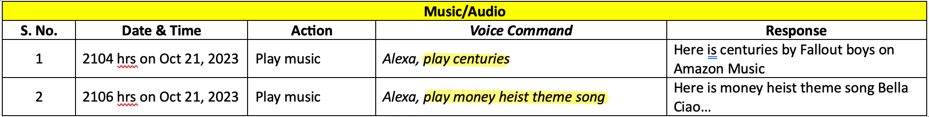
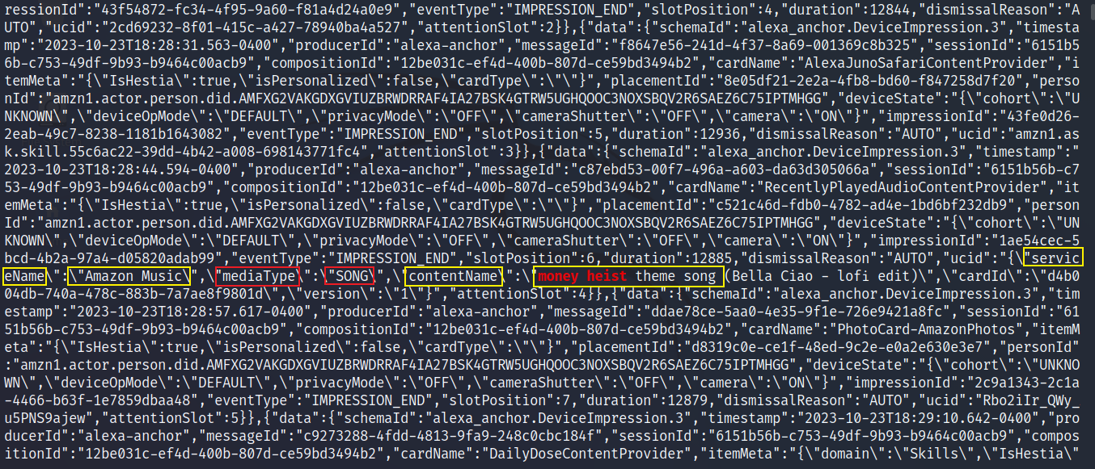
Echo Show Log File
Scroll down and look for red highlighted search keyword

Slide 4
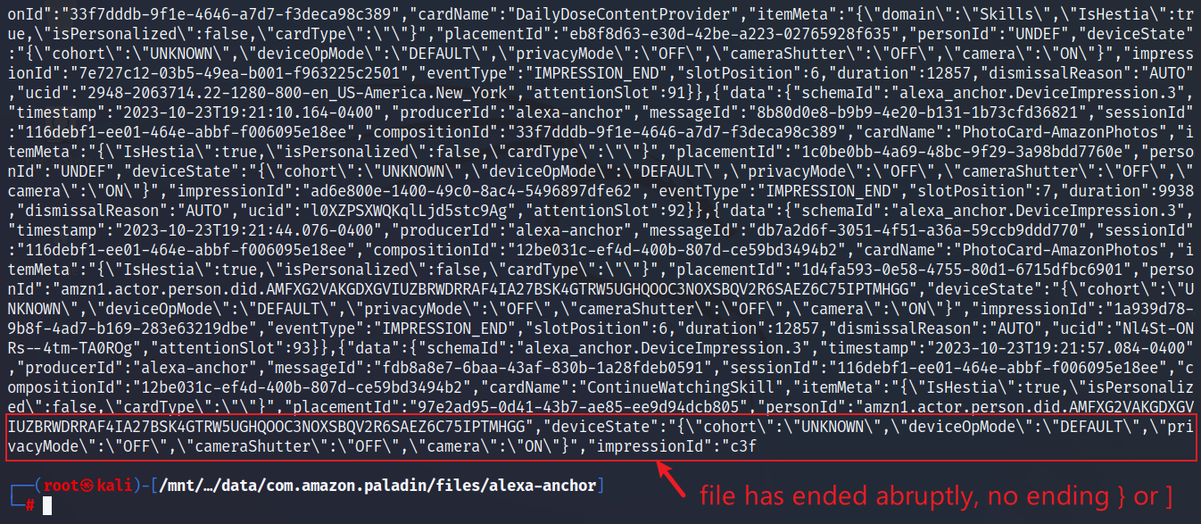
Echo Show Log File
Looks like a JSON format
But not easily readable
Convert to JSON and view in JSON format
The last JSON object is incomplete
Scroll down to the end of file

Slide 5
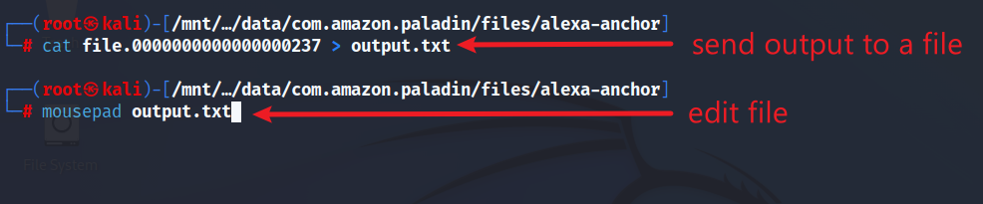
Edit Log File To Convert to JSON Format
Save file output in a text file and edit it

Slide 6
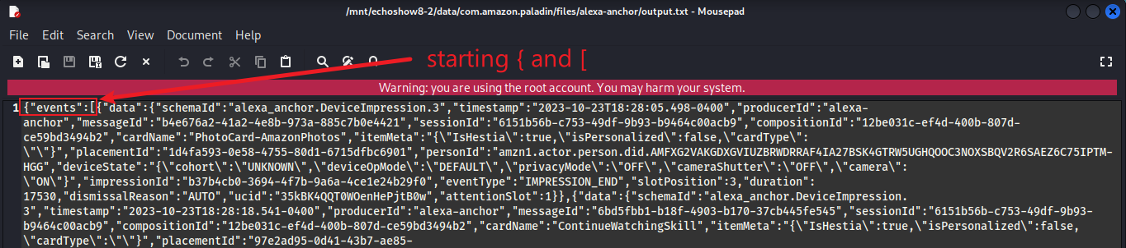
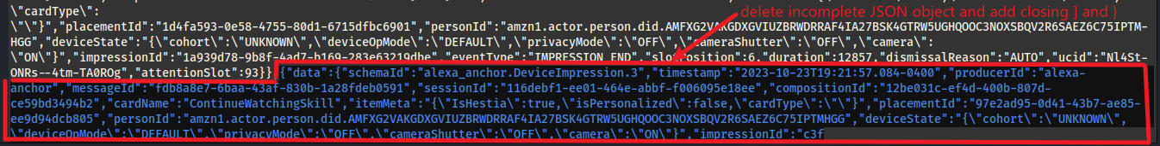
Edit Log File TO Convert to JSON Format
Starting JSON object element { and starting JSON array element [
Delete incomplete JSON object

Slide 7
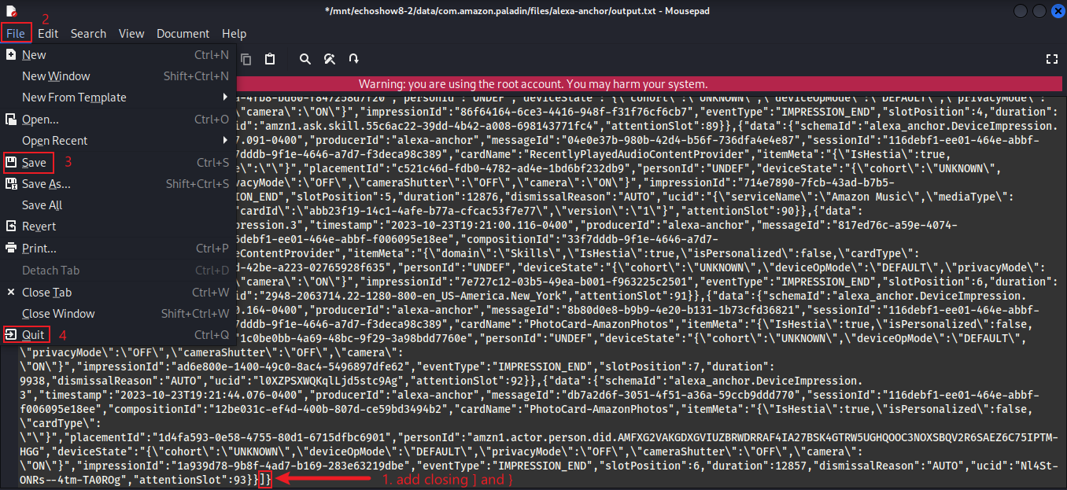
Edit Log File To Convert to JSON Format
Add ] and } at the end of file, save and quit

Slide 8
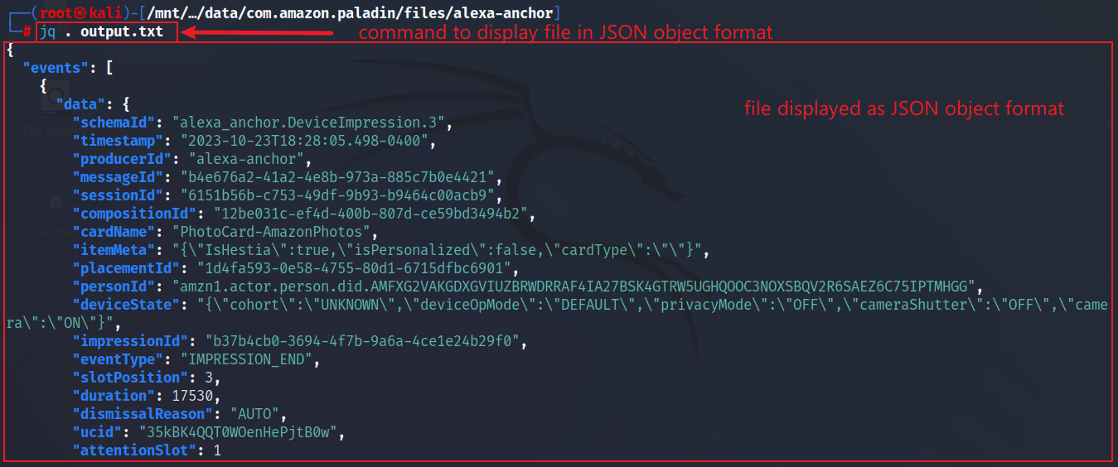
Edit Log File To Convert to JSON Format
Use jq command to view the edited text file in JSON format

Slide 9
Compare the Original Log File Output with JSON Format
Original log file output
JSON format log file output

Slide 10
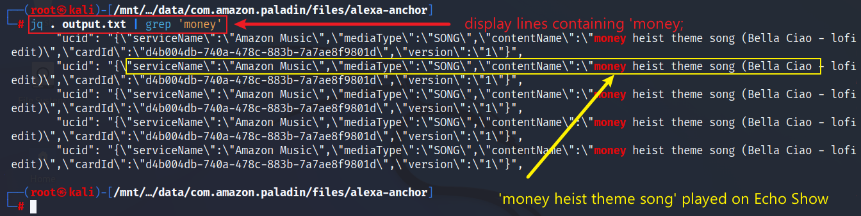
Search Log File For Evidence - Songs
Search song keyword in JSON format file

Slide 11
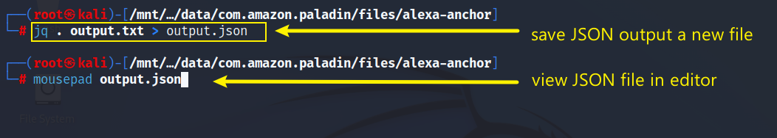
Convert to JSON Format
Save jq command output as a JSON file and view in editor

Slide 12
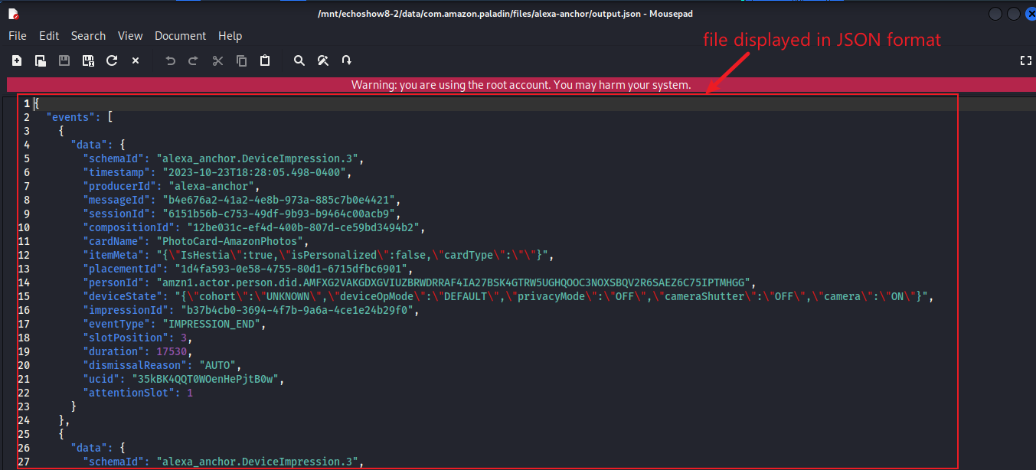
View Newly Created JSON File
View the JSON file in editor

Slide 13
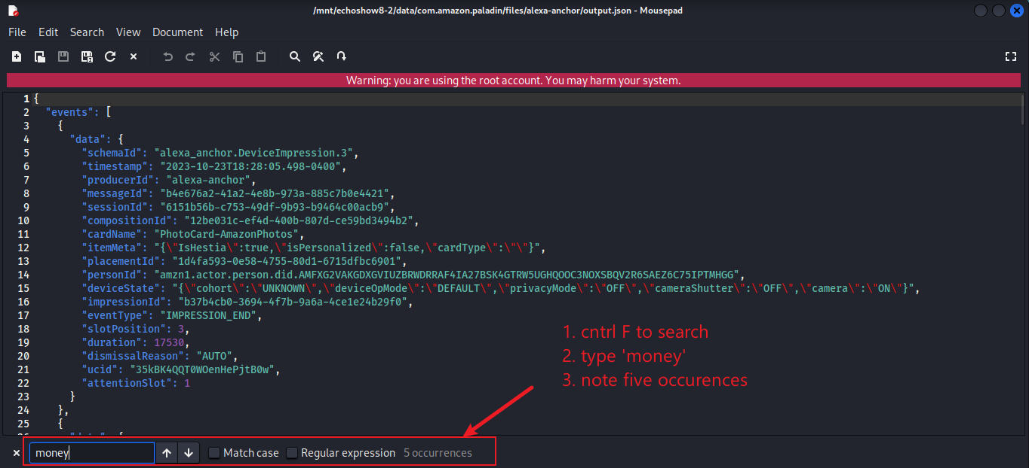
Analyse the JSON File (Log File)
Search for song keyword ‘money’ in the JSON file in editor

Slide 14
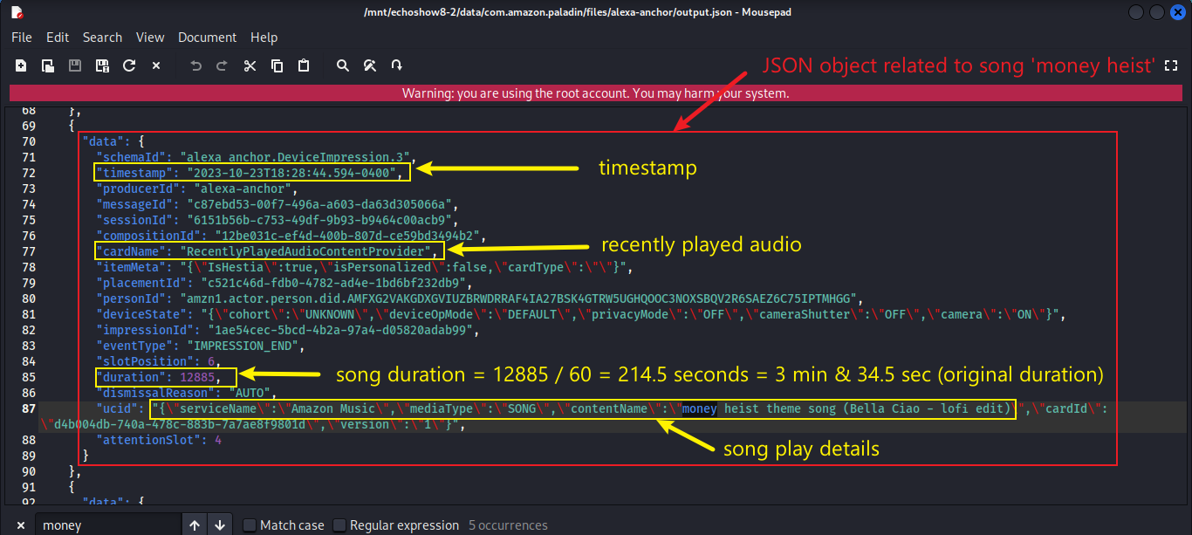
‘Money Heist Theme Song’ Played
The timestamp from the data population does not match the output because this is last day/hour log file
Song played details

Slide 15
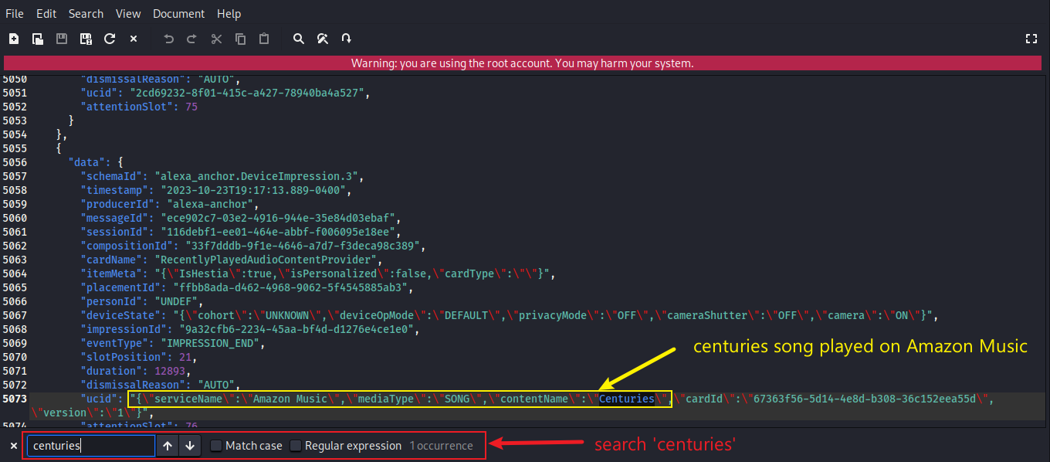
‘Centuries’ Song Played
Song played details

Slide 16
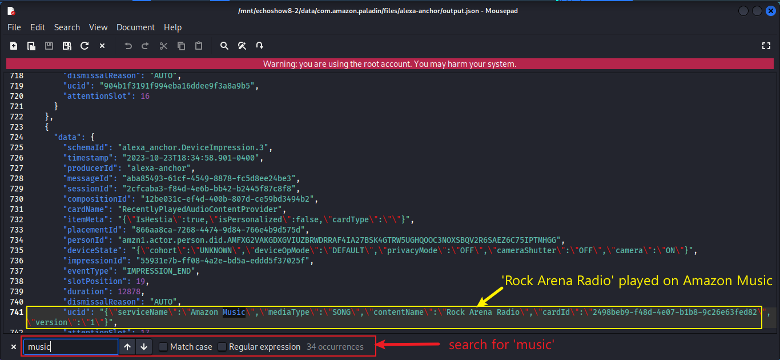
Log File Reveals Other Information - Music
‘Rock Arean Radio’ music played

Slide 17
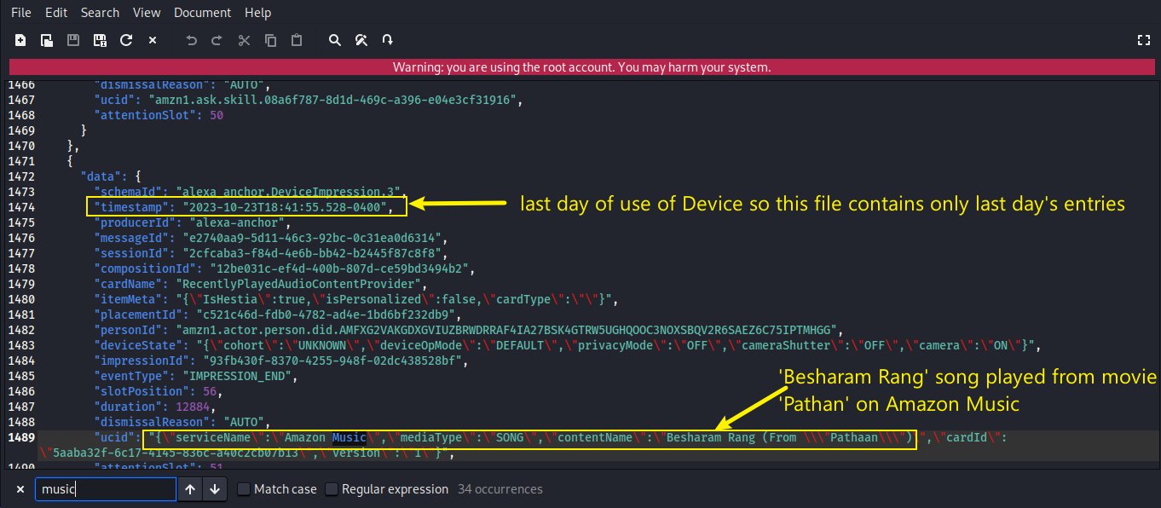
Log File Reveals Other Information - Music
‘Besharam Rang’ song from ‘Pathan’ played

Slide 18
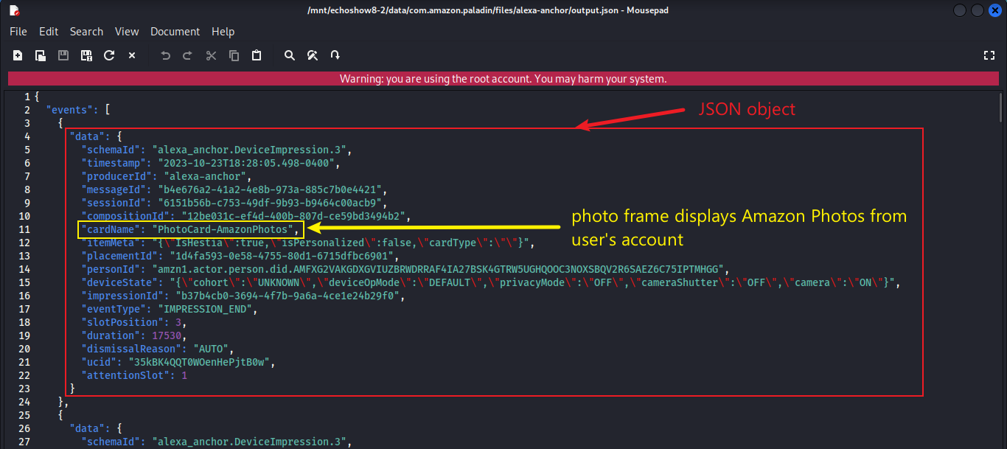
Log File Reveals Other Information – Photo Frame
Photo frame picture displayed

Slide 19
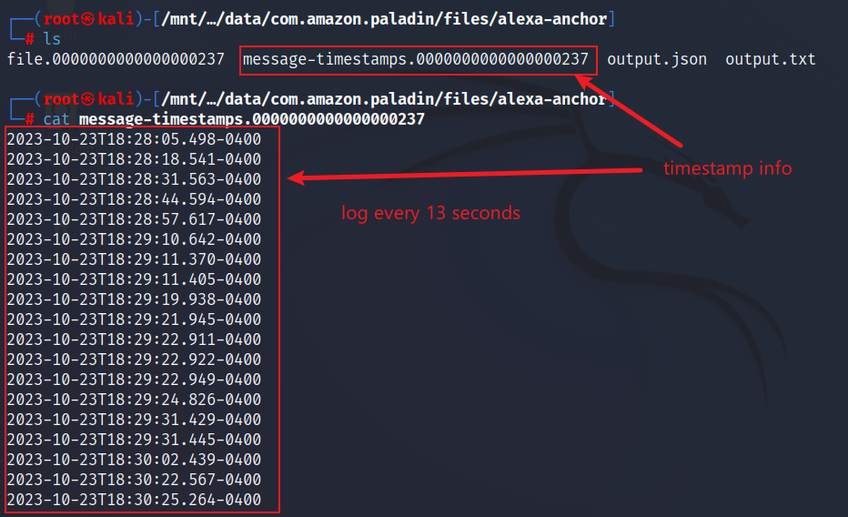
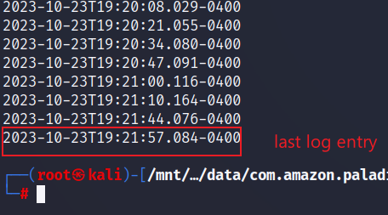
Log File Timestamp
View timestamps file

Slide 20
Finding Previous Log Entries
The log file provides log of activities of the last day and last hour only
Previous entries can be found in ’elf’ files in unallocated space
ELF (Executable and Linkable Format) file is a binary file format used for executable files, object code, shared libraries, and even core dumps
Therefore, we must first carve ‘elf’ files from unallocated space

Slide 21
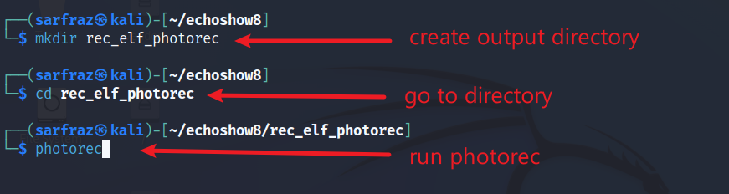
Carving ‘elf’ Files Using Photorec
Create directory and run Photorec

Slide 22
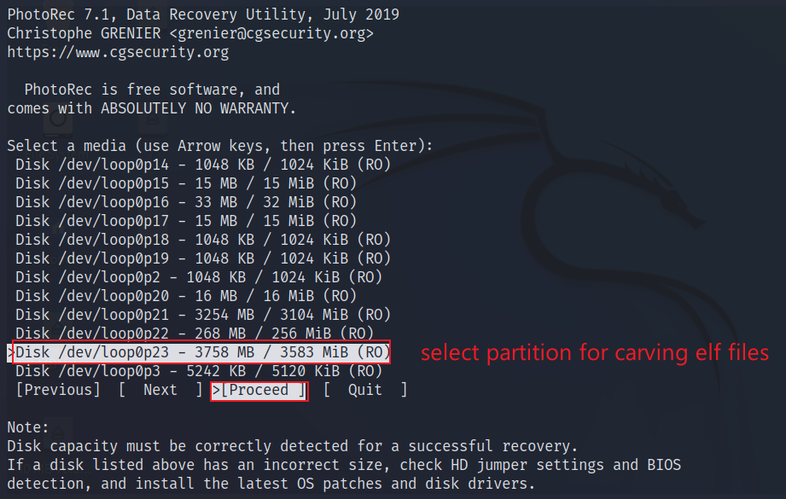
Carving ‘elf’ Files Using Photorec – Step 1

Slide 23
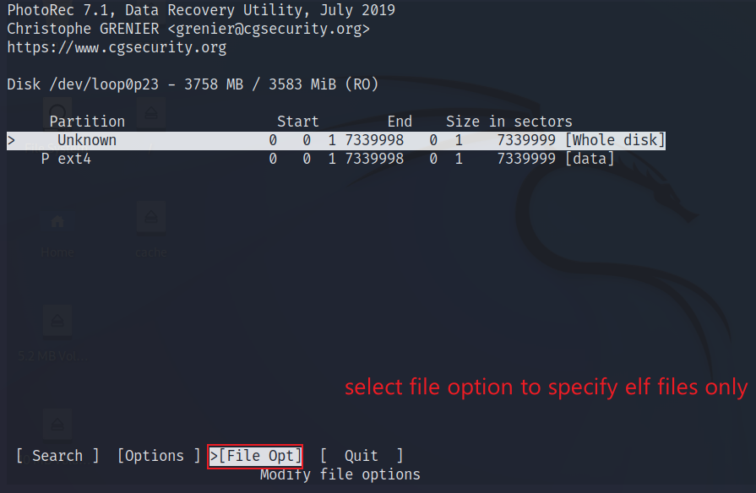
Carving ‘elf’ Files Using Photorec – Step 2

Slide 24
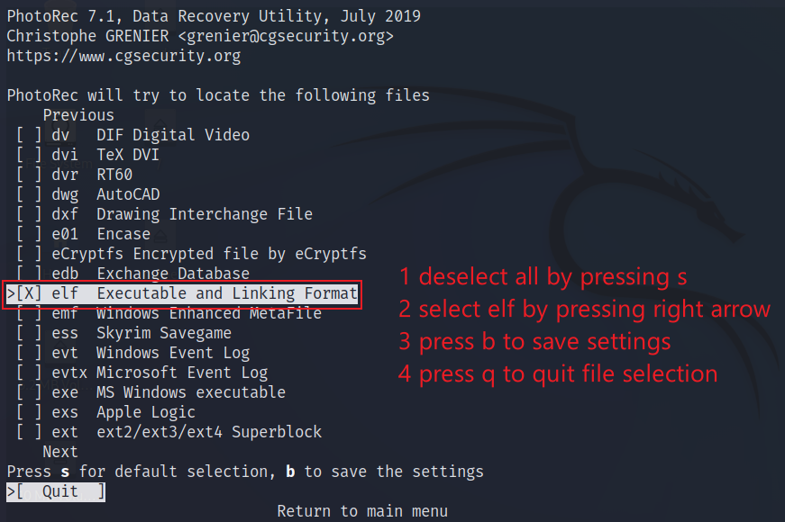
Carving ‘elf’ Files Using Photorec – Step 3

Slide 25
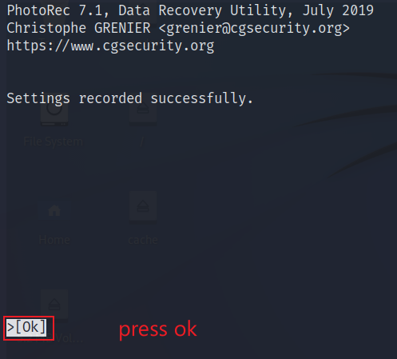
Carving ‘elf’ Files Using Photorec – Step 4

Slide 26
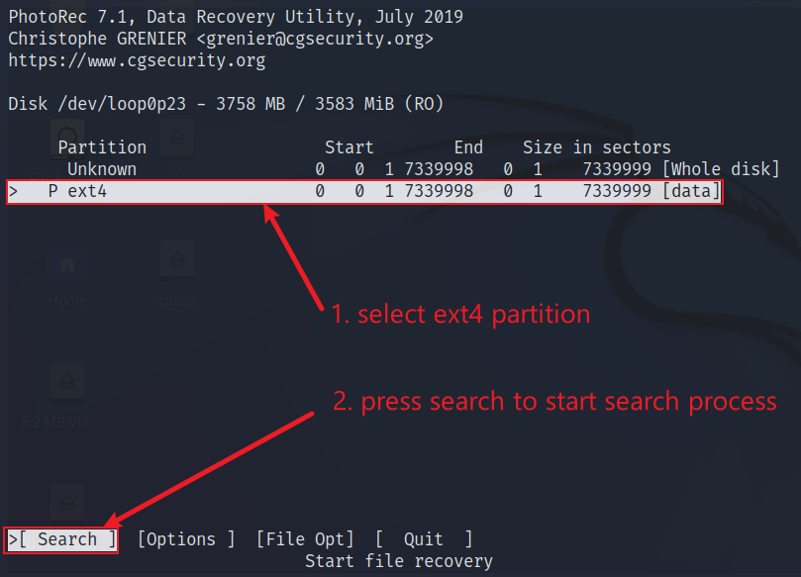
Carving ‘elf’ Files Using Photorec – Step 5

Slide 27
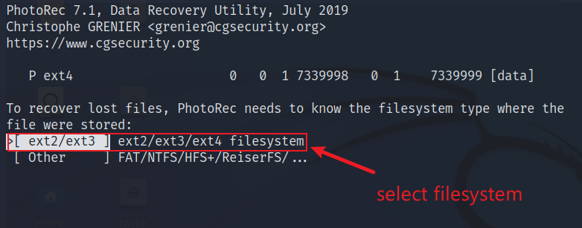
Carving ‘elf’ Files Using Photorec – Step 6

Slide 28
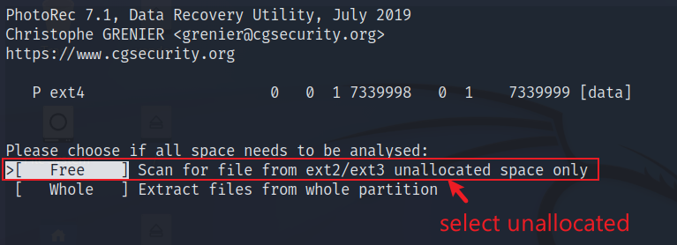
Carving ‘elf’ Files Using Photorec – Step 8

Slide 29
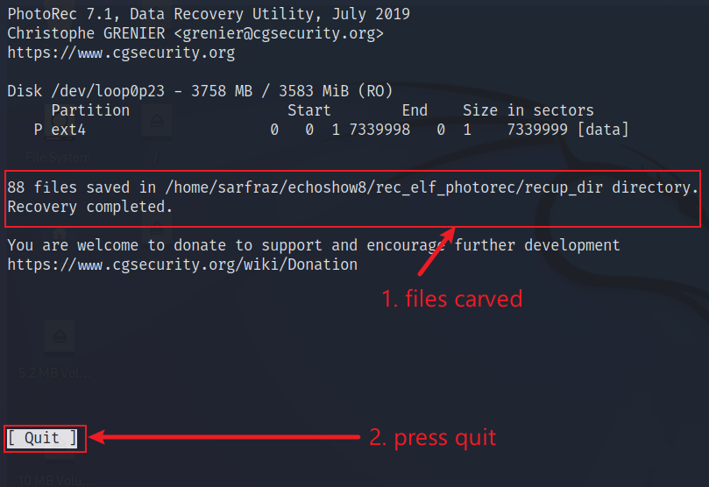
Carving ‘elf’ Files Using Photorec – Step 9

Slide 30
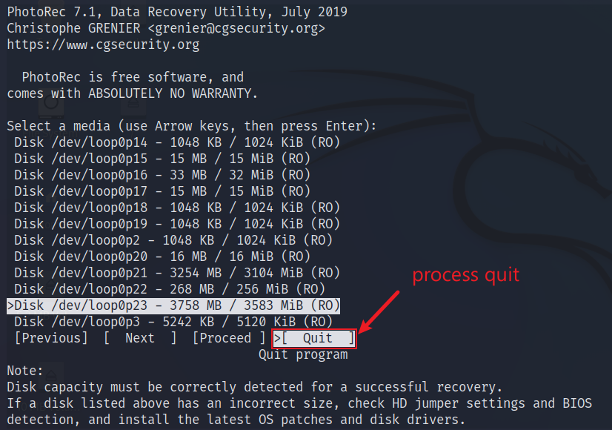
Carving ‘elf’ Files Using Photorec – Step 10

Slide 31
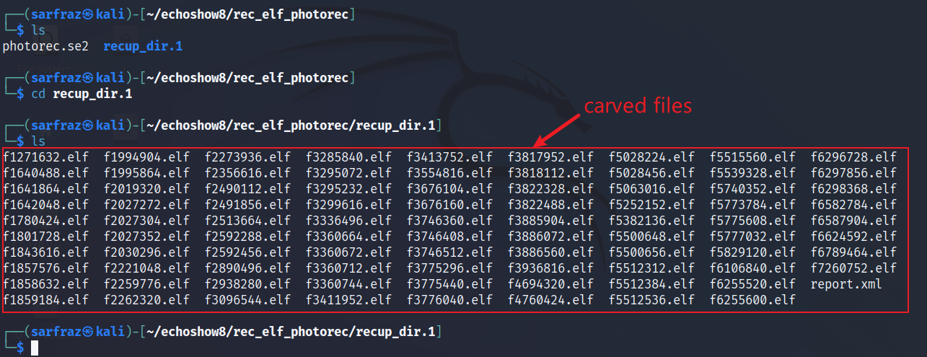
Carved ‘elf’ Files
List files carved by Photorec in output directory

Slide 32
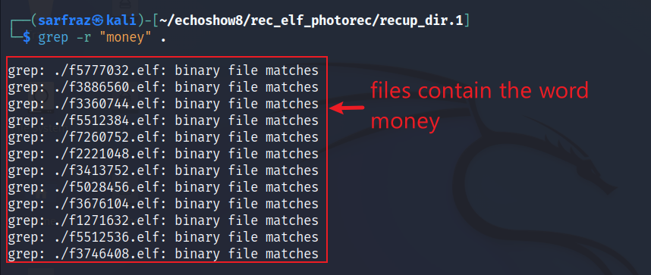
Carved ‘elf’ Files
Search song keyword in carved ‘elf’ file directory

Slide 33
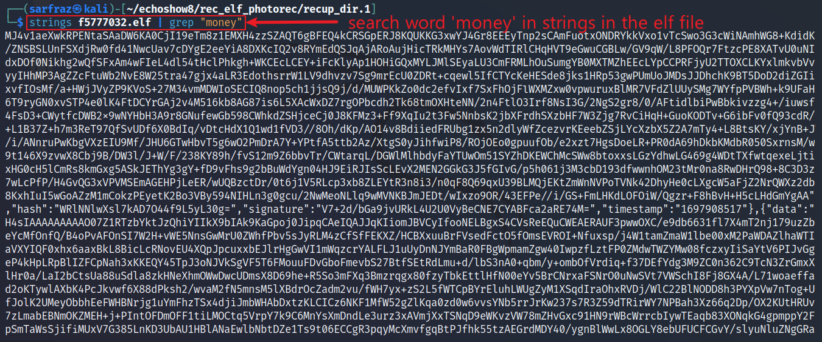
Carved ‘elf’ Files
View ‘elf’ file containing the song keyword

Slide 34
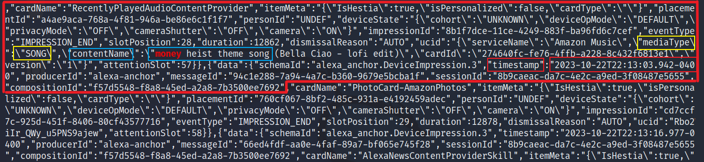
‘Money Heist’ Song Played
Scroll down and look for red coloured keywords
Note the timestamp shows the date as Oct 22, 2023, which is one day earlier than the last day that the log file showed, which was Oct 23, 2023

Slide 35
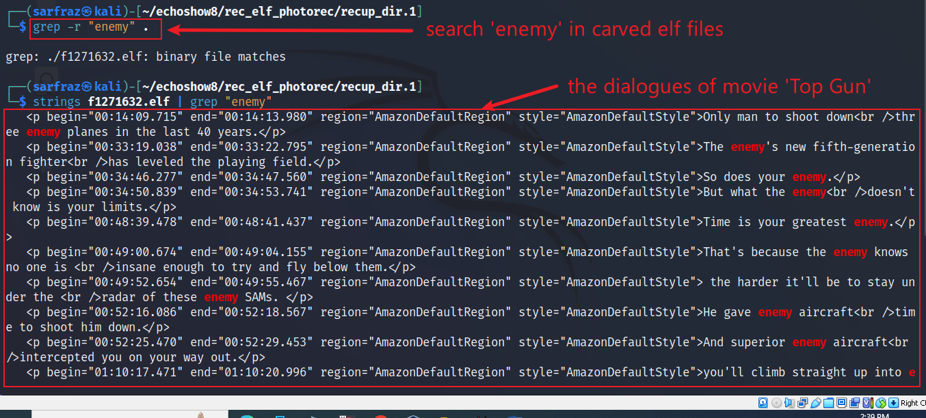
Carved ‘elf’ Files Carry Interesting Info
Search for ‘enemy; reveals dialogues of ‘Top Gun’ movie

